Slide 1
SPEECH EMOTION RECOGNITION
S M VISHNUPRIYA (2018115133)

Slide 2
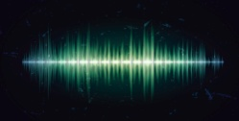
DESIGN FOR SPEECH EMOTION RECOGNITION:
Analyze
Audio file
Cleaning and masking of audio file
Feature extraction
Dataset audio
Feature extraction
prediction
Trained classifier
recording audio
Suggest video or quotes to boost your mindset
emotion

